Slide 1
Grainger
Void Management

Slide 2
Overview
As part of the larger Connect platform, Grainger PLC has successfully implemented Salesforce to manage the Lead-to-Lease process. This has transformed both internal operations and the customer journey. Grainger PLC are now looking to leverage Salesforce to realise similar benefits for the Void Management process.
Grainger PLC have engaged with Open Box to design a future-state Void Management process that can be implemented in their existing Salesforce org and aligns with Salesforce features and best practices.
Current Challenges with the Void Process:
No Visibility into Team Activity
Limited Performance Metrics
Lack of Ownership
Many Teams & Systems Involved
No Visibility into Comms over Email
Limited System Integration
Process Inefficiencies & Variations

Slide 3
Business Drivers
Grainger are planning on significant expansion, looking double their number of letting homes in the next 3-4 years.
The current systems and processes used in void management are not scalable to support this.
Leveraging the existing Salesforce platform and user licenses will help to:
Improve speed & efficiency
Reduce errors
Allow the business to scale operations without necessitating a linear increase in employee headcount
Minimize the time that units remain vacant
Improve customer satisfaction - reduce the risk of not cancelling direct debits or returning deposits on time & create a single view of customer

Slide 4
Vision and Objectives
Project Vision :
A centralized, standardized void workflow that tracks the end-to-end void progress, minimizes delays, and provides visibility into upcoming work, expected timelines & responsibilities.
The solution will be delivered in increments, providing tangible business value on a regular basis.
Key Objectives :
Measure Targets, Timeframes & KPIs
Visibility into Progress, Delays & Forecasted Completion
Visibility into Team Workload
Standardise Process while Allowing for Flexibility
Automate Notifications to Internal Teams
Move Towards Single View of Customer & Property
Clear Responsibility

Slide 5
Context Diagram

Slide 6

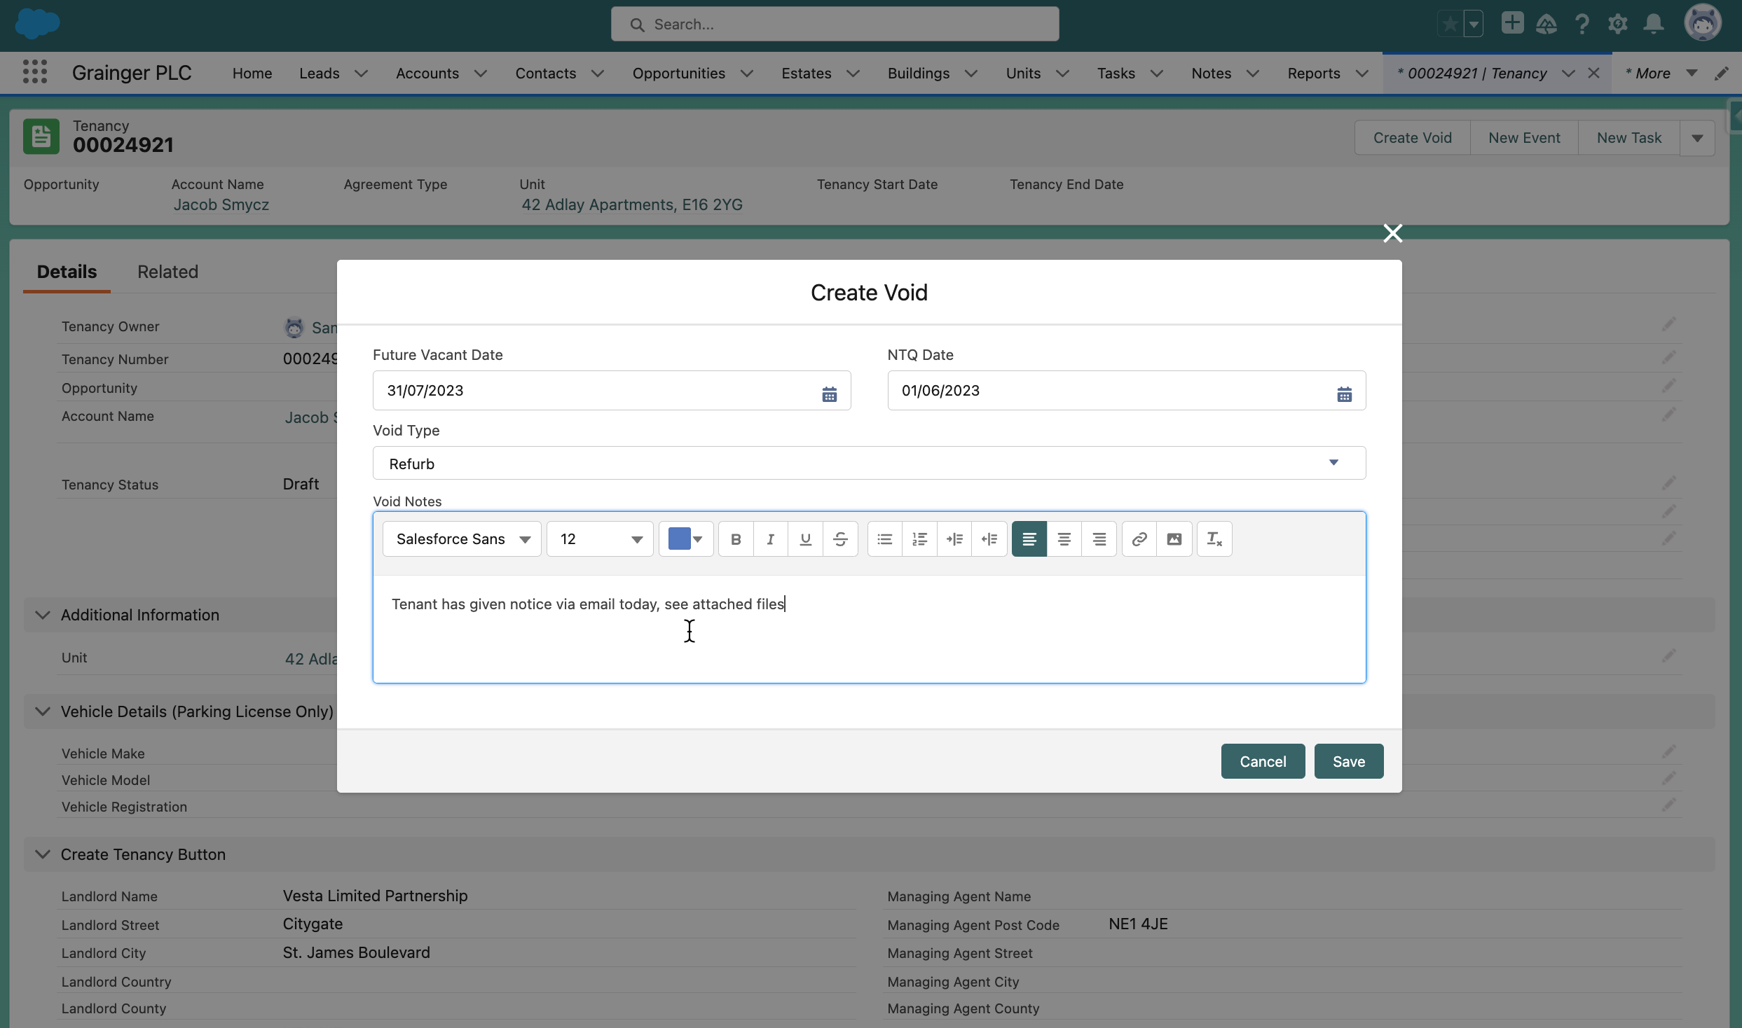
Proof of Concept
Initiate a new void from the relevant Tenancy

Slide 7
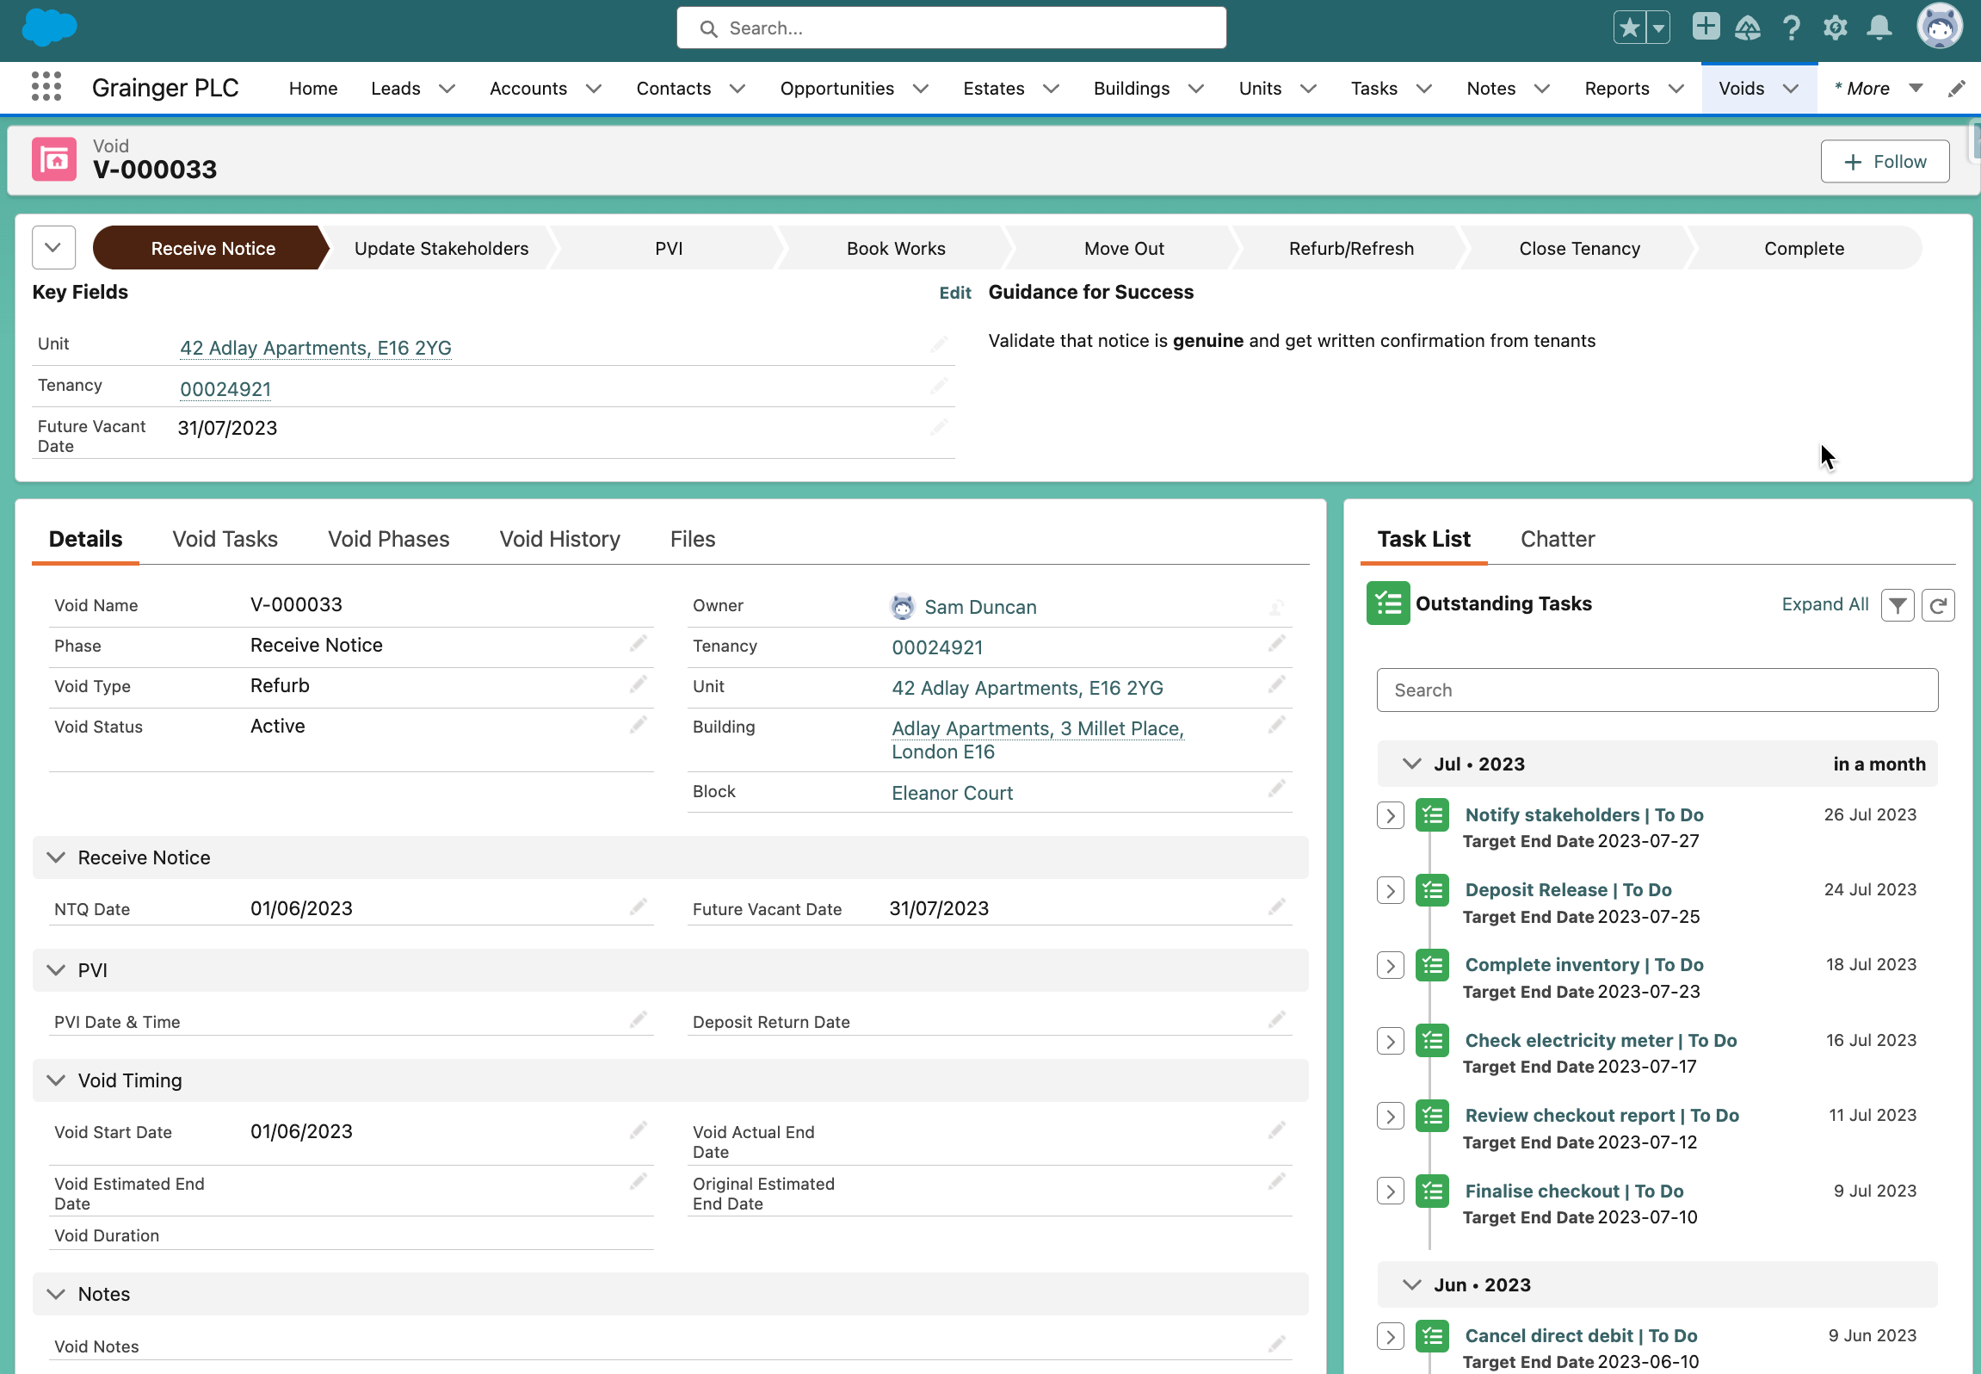
Proof of Concept
Void record creates single source of truth for collaboration & tracking of all void activities
Tasks created with due dates based on void start & future vacant date

Slide 8
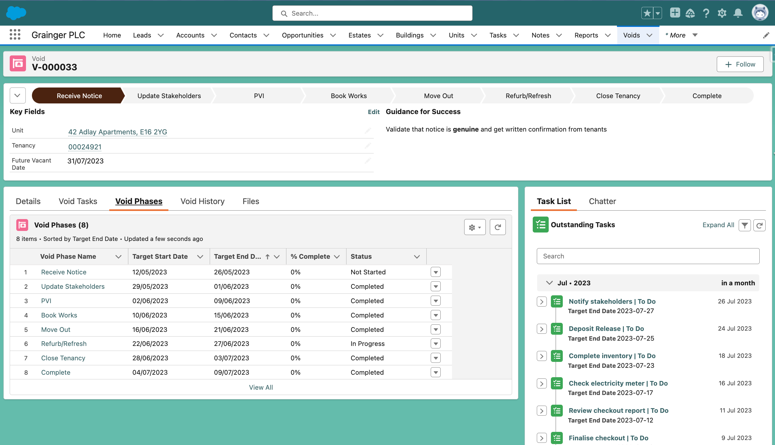
Proof of Concept
Phases with projected start & end dates

Slide 9
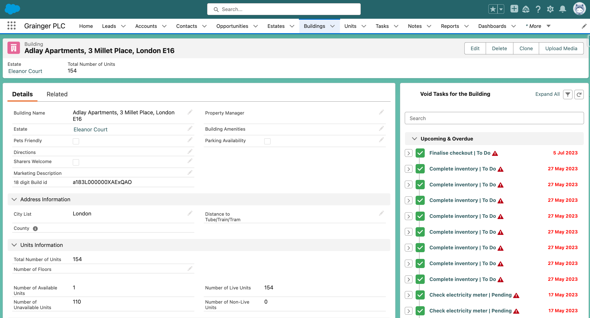
Proof of Concept
Consolidated view of tasks at building level

Slide 10
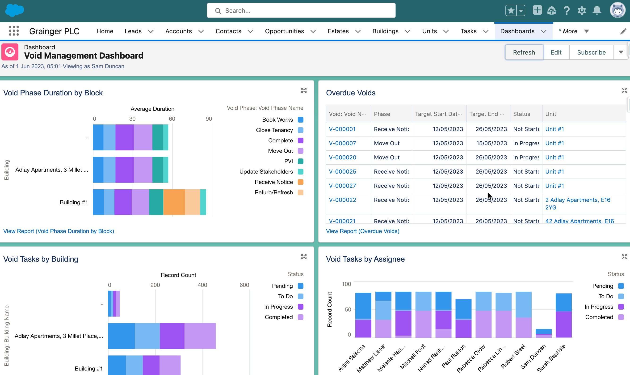
Proof of Concept
Reports & Dashboards to give visibility into KPI's, overdue tasks, workload by user, etc.

Slide 11

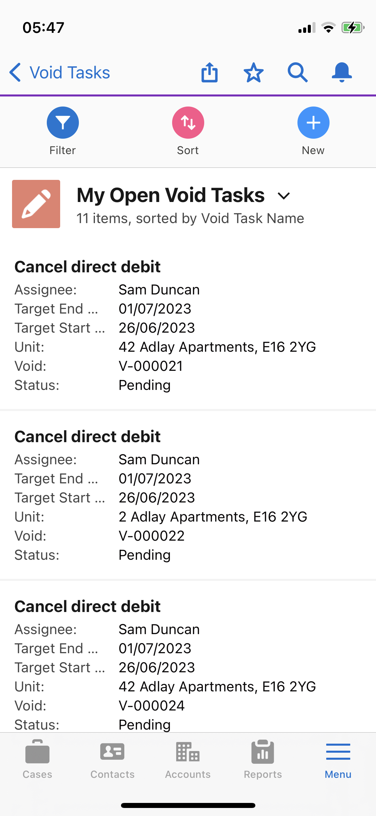
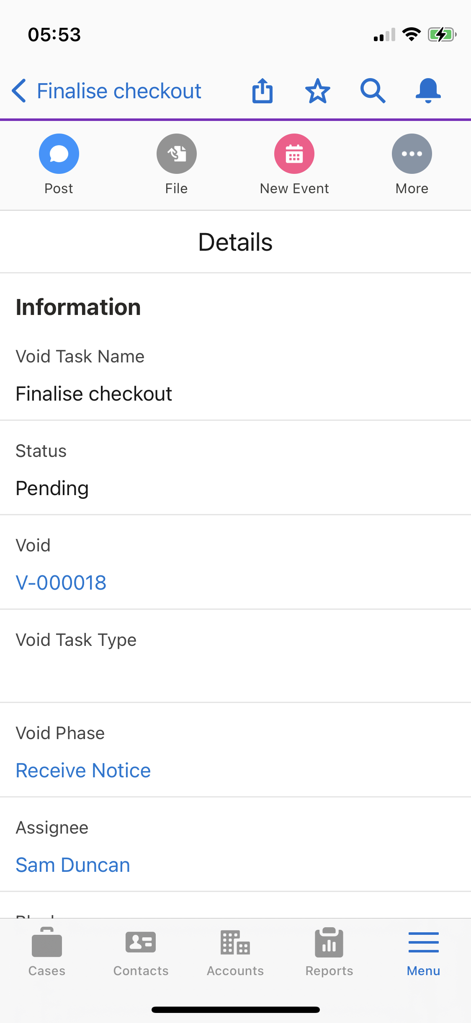
Proof of Concept
View and complete tasks on the mobile app
Attach photos

Slide 12



Agile Delivery Approach
Iterative delivery is achieved through a series of 3-week sprints
Process Improvement
Sprint Retrospective
Open Box Activity
Grainger Activity
Joint Activity
Daily Stand-up
3-week Sprint
Sprint Planning
Sprint Demo
Testing
Product Increment
Sprint Backlog
Product Backlog
Backlog Refinement & Prioritisation
Backlog Refinement
Feedback
Notes:
An agile delivery approach allows early delivery of outcomes & provides flexibility to adjust for opportunities or issues uncovered during the project.
A living backlog will track outcomes to be delivered & relative priority. This will evolve as we collaborate towards maximising value delivered.
The delivery team will meet Grainger representatives every 3 weeks to demonstrate the outcomes delivered in the past 3-week period & plan which outcomes will be worked on in the next 3-week period.
Feedback will be incorporated into the backlog and updated forecasts will be communicated.

Slide 13
Proposed Roadmap
Release 1
Future
Create & Complete End-to-End Void Workflow
Calculating & Revising Estimated Timelines
Update Salesforce Unit
User/Team Task Lists
Dashboards - KPIs & Voids Behind Schedule
See Voids by Unit & Building
Property Calendar of Onsite Void Tasks
Upload Void Documents
Audit History
Replace Internal Notification Emails
Qube Integration
EPCs
FSI Integration
Enhanced Property Calendar (Include Viewings & Other Building Activity)
Advanced Dashboards (Trends & Comparisons)
Online Tenant Instructions (DRI)
Additional Void Workflows (Tenant Already Vacated, Give Notice to Vacate, Garage & Parking Bay Voids, Tenant Rescinds NTQ, Custom Tasks)
Additional Task Details (Refurb, PVI Checklist, Detailed Works)
Incorporate Delays
Automated Emails to Tenants (Move In & Move Out)
Customizing Turnaround Times, Non-Working Days
Void Variations - Unit Sale, Relet, ​ Clean vs Refurb vs Refresh
Auto Assign Tasks to Individuals
2023
1
July
30 Sept
Notes:
Release 1
This is at the current point in time, likely to change as the project progresses. But it is put together based on the process we’ve designed with Scott and Jacob and is tied to the demo we’ve built to showcase the hypothesized design with phases and tasks. i.e. we are not just grouping random development items, we are choosing the “stripe” of functionality required to cover the void process end-to-end.
Release 1 requirements:
No additional licenses (assuming all actors already have licenses)
No new integrations
No migration of historical data
Data/file volumes may require archival strategy in the future
Items outside of void process
Building out renewal functionalty to be integrated with voids & tenancies
Move In workflow
Pricing playbook
Tenant arrears in Salesforce
Complaints register
Minimising double entry in Hive
We have sprint 1 ready to go, we are ready to go in July

Slide 14
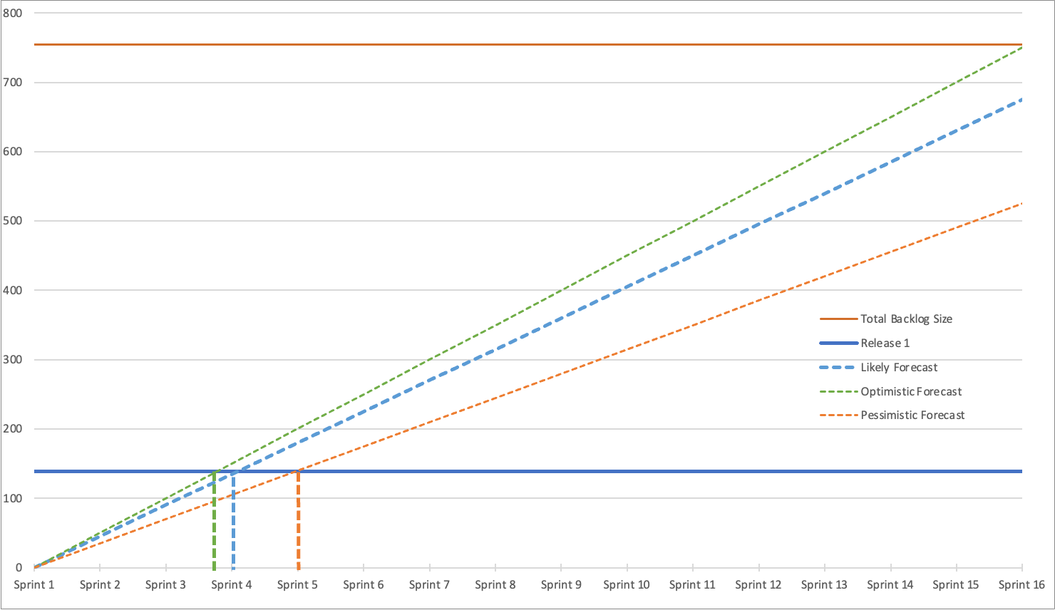
Release 1 Forecast
Likely: 4 sprints = 12 weeks

Slide 15







Project Team & Forecasted Costs
Open Box Delivery Team
1 Month
Release 1
Salesforce Architect
Business Analyst
Developers
Quality Assurance
Project Manager
4 sprints
520
effort
hours / month
3 months
GRAINGER Delivery Team
£46 735
duration
Product Owner - Main point of contact
monthly cost
£140 205
Subject Matter Experts Project Sponsor - Involved in Demos & UAT
Change Management & End User Training Specialist
total cost
Notes:
All figures are forecasted as at current business asks

Slide 16
Next Steps
Grainger to confirm they would like to move forward
Open Box to deliver a Statement of Work for a 3-month engagement to deliver the first release of Void Management

Slide 17
Appendix

Slide 18
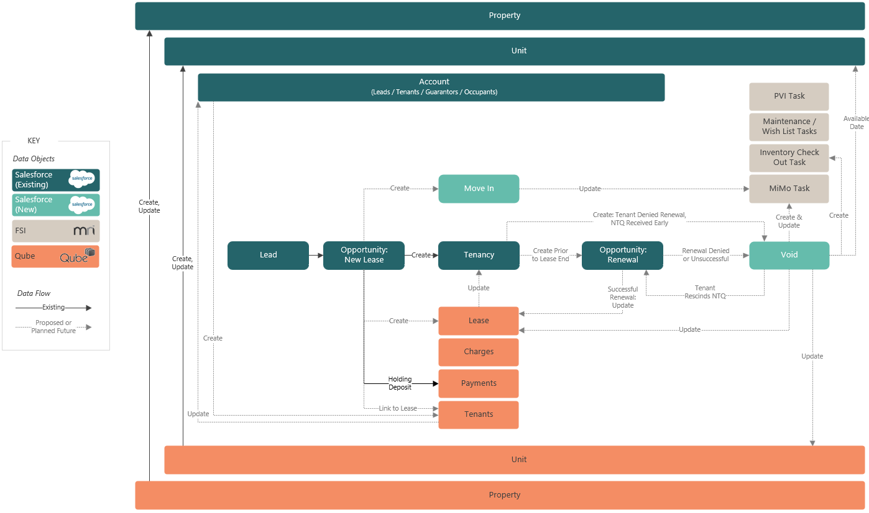
Future-State Process: High Level Tenant Lifecycle & Data Flow

Slide 19
Future-State Process: Void Workflow Example

Slide 20
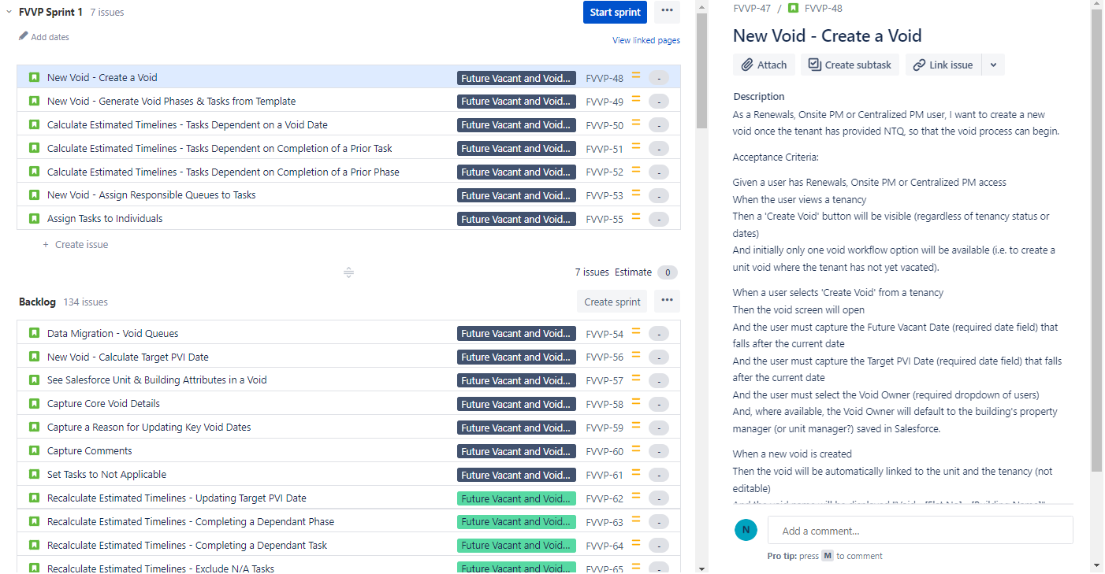
Jira Feature Backlog

Slide 21
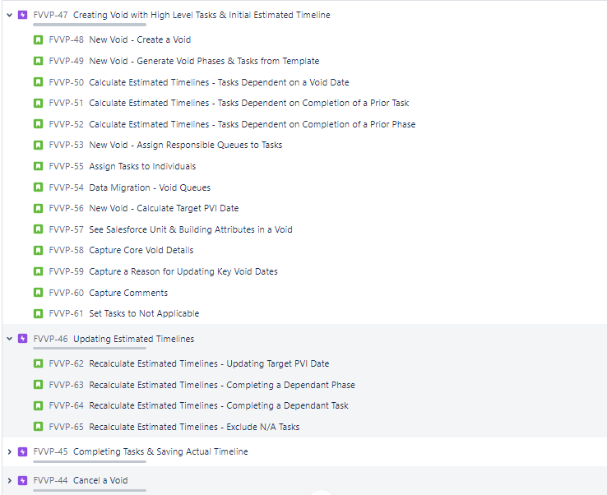
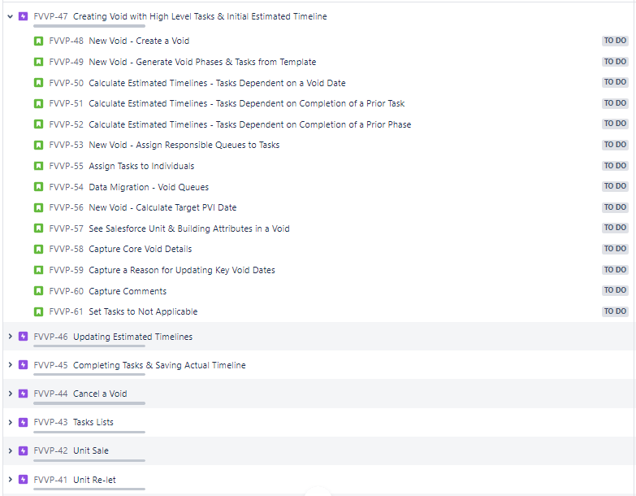
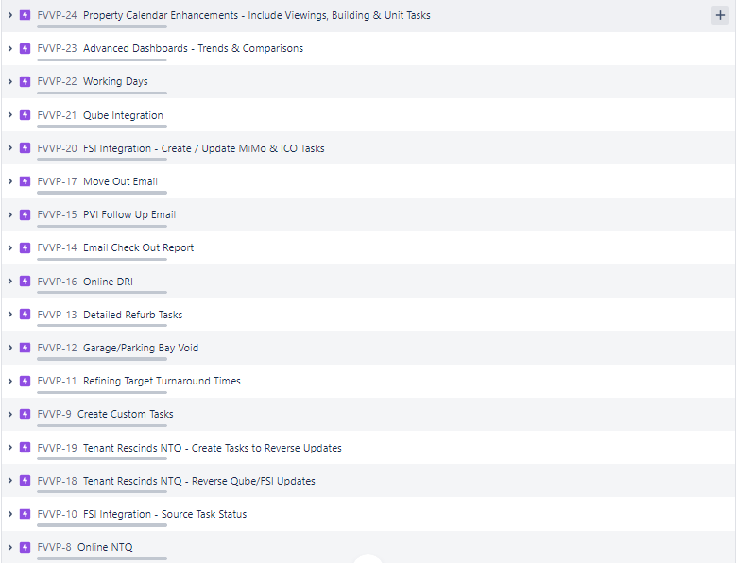
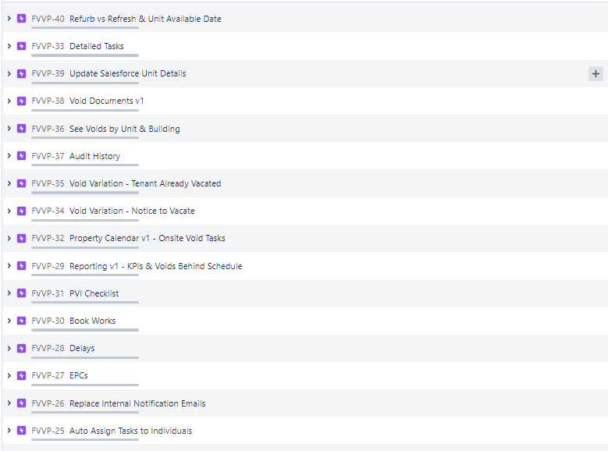
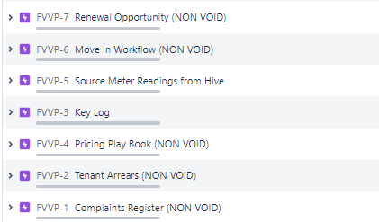
Jira Feature Backlog

Slide 22
Proposed Data Model

